Slide 1









My Number Interactive Notebook
$$×$$
$$\frac{1}{2}$$
$$÷$$
$$+$$
$$−$$
$$\frac{3}{5}$$
$$7$$
Name
Class
Teacher
Term 1 Semester 1
$$5^{2}$$
$$\sqrt{9}$$
1

Slide 2
Contents
Glossary or Formula Page
Page
Date
Description
2
3

Slide 3
Tasks
24
7
30
Essential Question
Questions
Notes
Summary

Slide 4
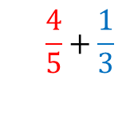
24
7
30
Date
Addition and Subtraction of Fractions
EQ – How do I use equivalent fractions to add and subtract fractions
What is the process for adding and subtracting fractions?
Make the denominators the same.
$$\frac{4}{5}+\frac{1}{3}$$

Slide 5
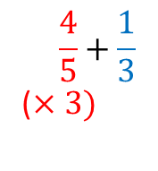
24
7
30
Date
Addition and Subtraction of Fractions
EQ – How do I use equivalent fractions to add and subtract fractions
What is the process for adding and subtracting fractions?
Make the denominators the same.
$$\frac{4}{5}+\frac{1}{3}$$
($×3)$

Slide 6
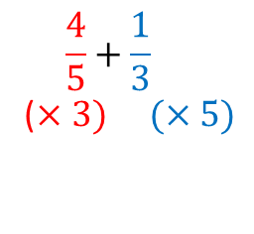
24
7
30
Date
Addition and Subtraction of Fractions
EQ – How do I use equivalent fractions to add and subtract fractions
What is the process for adding and subtracting fractions?
Make the denominators the same.
$$\frac{4}{5}+\frac{1}{3}$$
($×3) (×5)$

Slide 7
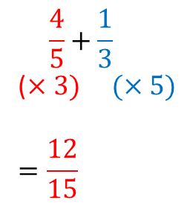
24
7
30
Date
Addition and Subtraction of Fractions
EQ – How do I use equivalent fractions to add and subtract fractions
What is the process for adding and subtracting fractions?
Make the denominators the same.
$$\frac{4}{5}+\frac{1}{3}$$
($×3) (×5)$
$$=\frac{12}{15}$$

Slide 8
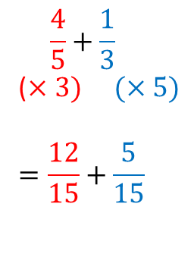
24
7
30
Date
Addition and Subtraction of Fractions
EQ – How do I use equivalent fractions to add and subtract fractions
What is the process for adding and subtracting fractions?
Make the denominators the same.
$$\frac{4}{5}+\frac{1}{3}$$
($×3) (×5)$
$$=\frac{12}{15}+\frac{5}{15}$$

Slide 9
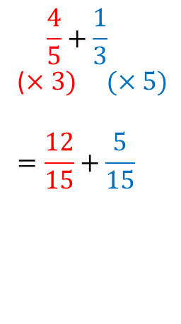
24
7
30
Date
Addition and Subtraction of Fractions
EQ – How do I use equivalent fractions to add and subtract fractions
What is the process for adding and subtracting fractions?
Make the denominators the same.
Add or subtract the numerators.
$$\frac{4}{5}+\frac{1}{3}$$
($×3) (×5)$
$$=\frac{12}{15}+\frac{5}{15}$$

Slide 10
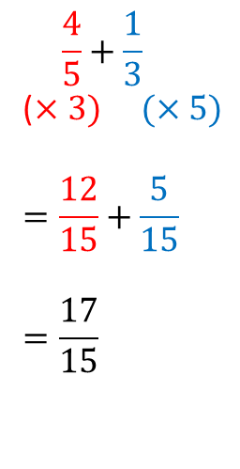
24
7
30
Date
Addition and Subtraction of Fractions
EQ – How do I use equivalent fractions to add and subtract fractions
What is the process for adding and subtracting fractions?
Make the denominators the same.
Add or subtract the numerators.
$$\frac{4}{5}+\frac{1}{3}$$
($×3) (×5)$
$$=\frac{12}{15}+\frac{5}{15}$$
$$=\frac{17}{15}$$

Slide 11
24
7
30
Date
Addition and Subtraction of Fractions
EQ – How do I use equivalent fractions to add and subtract fractions
What is the process for adding and subtracting fractions?
Make the denominators the same.
Add or subtract the numerators.
Simplify
$$\frac{4}{5}+\frac{1}{3}$$
($×3) (×5)$
$$=\frac{12}{15}+\frac{5}{15}$$
$$=\frac{17}{15}$$

Slide 12
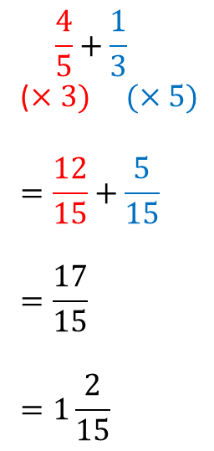
24
7
30
Date
Addition and Subtraction of Fractions
EQ – How do I use equivalent fractions to add and subtract fractions
What is the process for adding and subtracting fractions?
Make the denominators the same.
Add or subtract the numerators.
Simplify
$$\frac{4}{5}+\frac{1}{3}$$
($×3) (×5)$
$$=\frac{12}{15}+\frac{5}{15}$$
$$=\frac{17}{15}$$
$$=1\frac{2}{15}$$

Slide 13
Notes Review
24, 7 ,30
Date
Title
Essential question
Notes complete
Notes complete with colour and diagrams
Questions completed
Contents page filed in
Formula page filled in

Slide 14
Homework
Review your notes and write a summary answering the essential question.

